Slide 1
HR Analytics Dashboard
By
Muhammad Raheem Zada

Slide 2
Problem Statement
Develop a detailed and comprehensive HR Analytics dashboard.
Assist an organization in improving employee performance and reducing attrition rates.
Provide valuable insights into employee behavior and trends.
Enable data-driven decisions to enhance productivity and retention.

Slide 3
EDA & DAX
Removed duplicates from Employee ID Column.
Removed Null Values from year In current Role column.
Replaces some spelling mistakes in Business Travel Column.
Removed Duplicates from Salary Slab column.

Slide 4
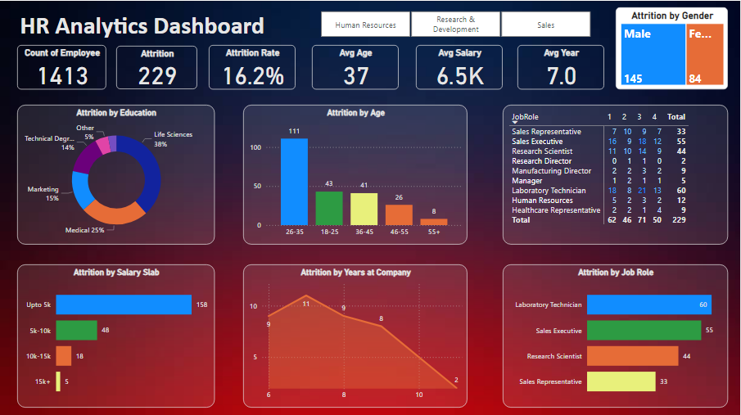
Reports & Dashboards

Slide 5
Insights
Overall Attrition Rate | 16.2%
Gender Insights | Males 145 and Females 84
Education Insights | Life Sciences (38%) and Medical (25%)
Age Insights | 26-35 age group
Salary Insights | up to $5K
Tenure Insights | within the first year
Job Role Insights | Laboratory Technicians (60) and Sales Executives (55)

Slide 6
Conclusion
Focus on New Hires
Review Compensation
Role-Specific Retention
Engage Younger Employees
Education-Specific Strategies

